Slide 1
A guide on how to upgrade / clone / restore your Jetson TX2
Yu Chen

Slide 2
What is JetPack?

Slide 3
JetPack version
JetPack is system kernel that supports lots of vital functions that sustain the Jetson module’s system OS.
A properly installed JetPack kernel contains an OS image, linux kernel, bootloader, all hardware drivers (e.g., GPU, wifi, Bluetooth, etc.), CUDA, and lots of deep learning and computer vision libraries.
Since JetPack is maintained by NVIDIA, you don’t need to worry about any compatibility issue.
But, if plan to use the latest, more advanced deep learning libraries for your project, better to check if the current JetPack version supports them. You can of course install updates on your own, but there is no guarantee that you won’t have compatibility issues.
https://docs.nvidia.com/jetson/jetpack/introduction/index.html

Slide 4
JetPack version
To check your current JetPack Version, use the following command in a terminal:
$ sudo apt-cache show nvidia-jetpack
You should be able to see something like this:
Package: nvidia-jetpack Version: 4.4-b144 Architecture: arm64 Maintainer: NVIDIA Corporation

Slide 5
JetPack Upgrade

Slide 6
JetPack upgrade
If you decide that the current JetPack version won’t satisfy your development needs, you can perform an upgrade on your Jetson module.
The upgrade process usually require a complete flash. Meaning you will lose all data stored on the device. So be sure to make your data backup first!
For the rest of the guide, we will need a micro USB cable, and a Ubuntu machine (at least Ubuntu 18.04, >60 Gb storage space) with internet connection.

Slide 7
Step 1 - Install NVIDIA SDK Manager
First, go to the following link and install the SDK manager:
https://developer.nvidia.com/nvidia-sdk-manager
(The .deb method is the easiest)
NVIDIA will require you to login every time you use the SDK manager, so register your own NVIDIA developer account and keep it handy.

Slide 8
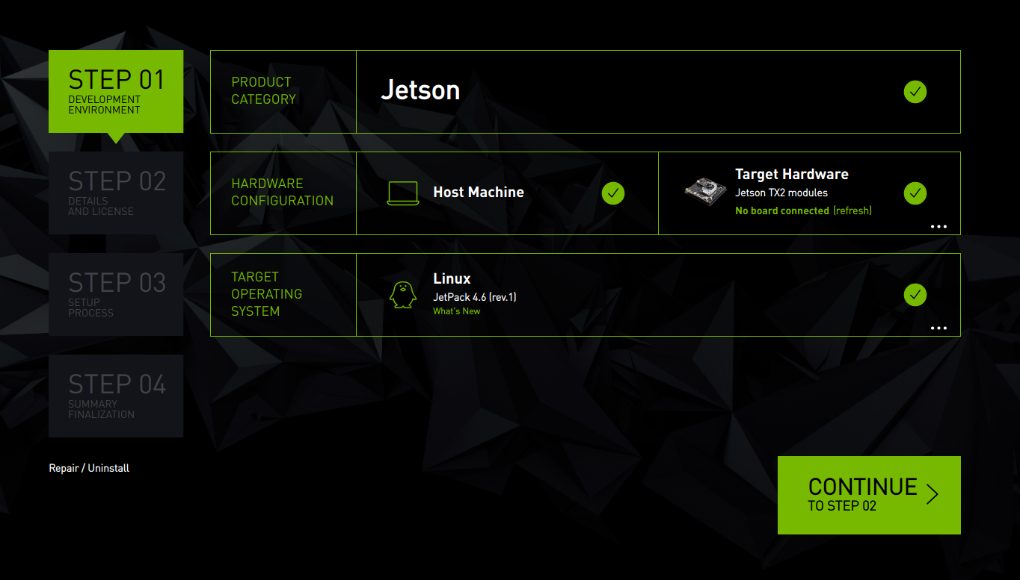
Step 2 - Select your hardware and JetPack version
Once login, you will see a screen like this.
The “Host Machine” is referring to the Ubuntu machine you are currently using, and the “Target Hardware” is the device you want to flash.
Now select your Target Hardware from the drop-down menu. If you are doing this for one of the Jackal robot, then likely the Target Hardware is a “Jetson TX2 modules” (ignore all the variants).
Then, choose your preferred “Target Operating System” (the JetPack version).
Once finished, click “CONTINUE”.

Slide 9
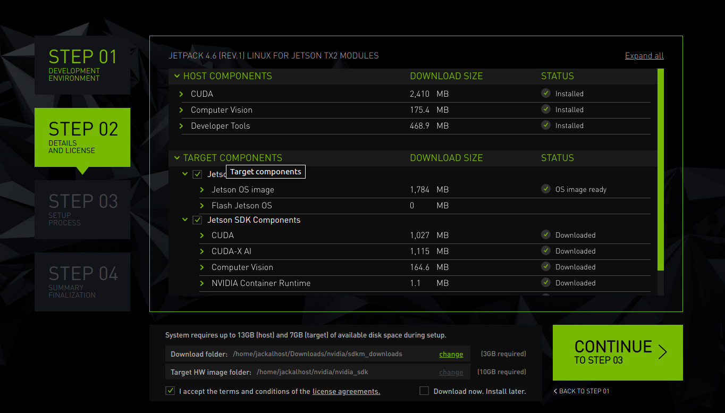
Step 3 - Specify file directories
Specify the directory that the SDK uses to download all the JetPack installation packages. They can be removed afterward to save disk space.
Then, specify the directory that the SDK uses to store the hardware image for your Jetson device. This directory is important for clone / restore, so take notes!
Finally, check the box here.

Slide 10
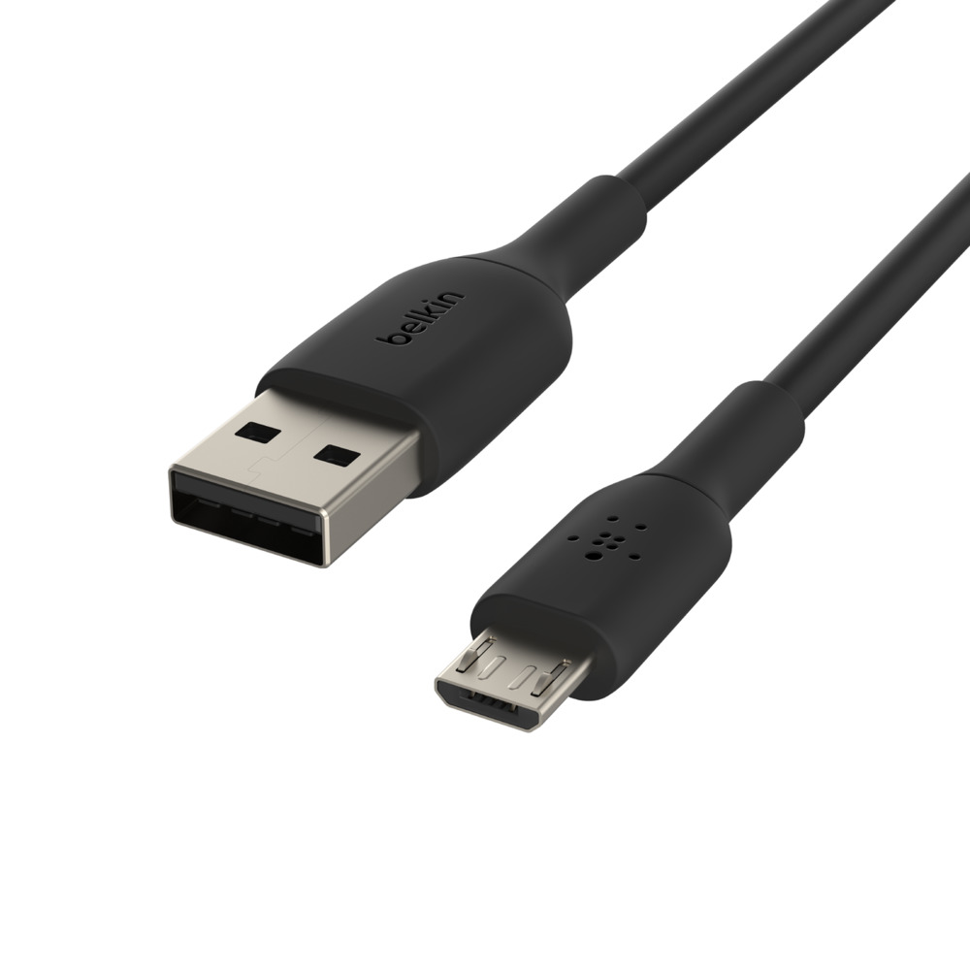
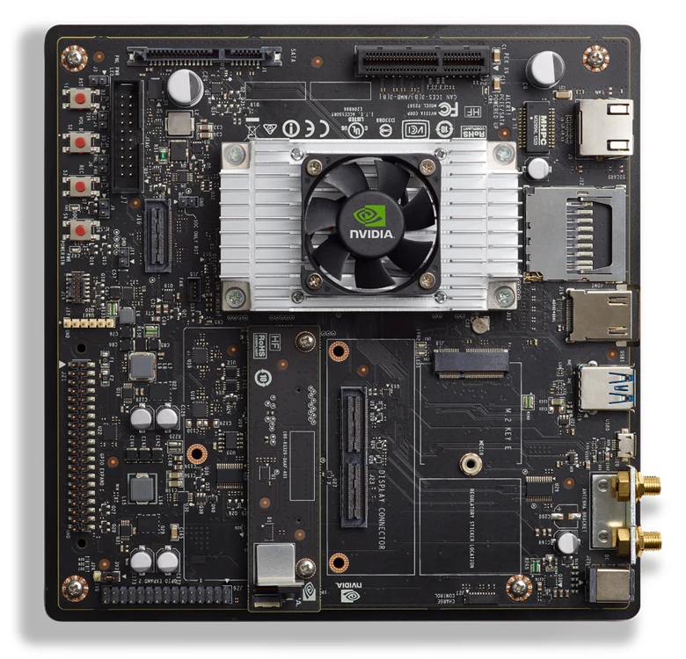
Step 4 - Connect your Jetson device in recovery mode
Take the USB Micro-B to USB A cable (included in the developer kit) and connect your Jetson TX2 to the Ubuntu machine.
Connect the power cable of TX2. If you are using a battery, make sure it has enough battery to last ~ 2 hours of operation.
Put TX2 into Force Recovery Mode:
Starting with the device powered off (disconnect and connect power cable).
Press and hold down the Force Recovery button (holding).
Press and hold down the Power button (1 sec).
Press the Reset button once.
Hold the Force Recovery button for another 10 sec
then release.
Here is a video guide:
https://www.youtube.com/watch?v=HaDy9tryzWc
Note the footage is mirrored for some reasons.

Slide 11
Step 5 - Proceed to next step
Once the Jetson device is put into recovery mode and properly connected to the Host Machine, click “CONTINUE”.

Slide 12
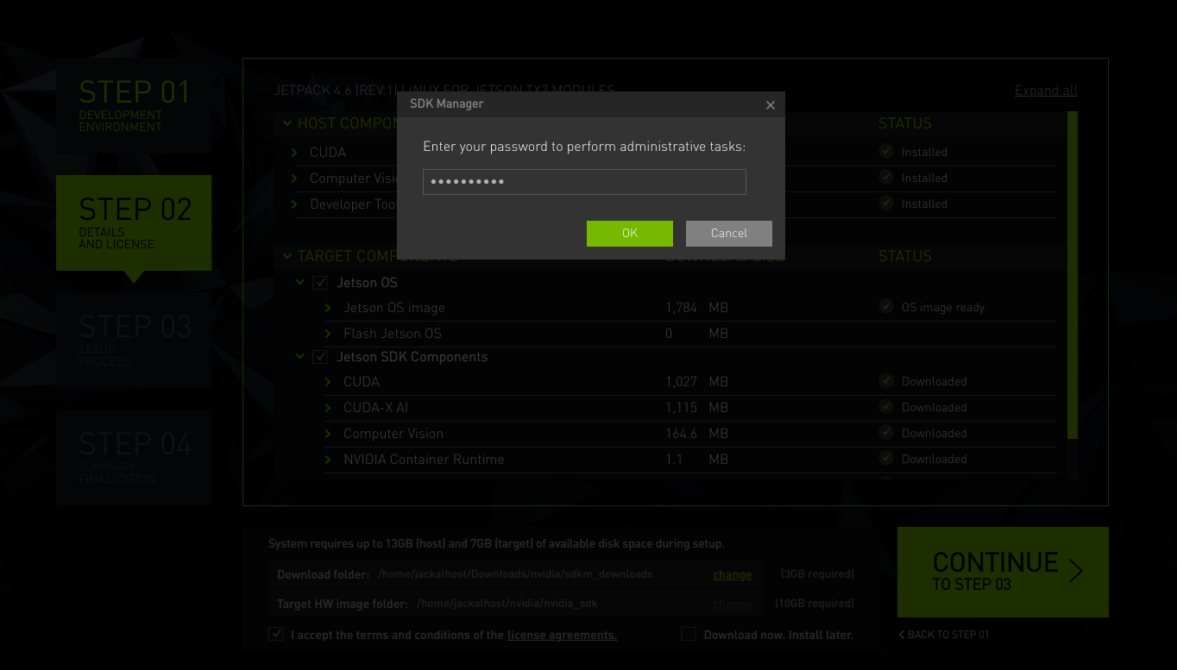
Step 6 - Type your Ubuntu account password

Slide 13
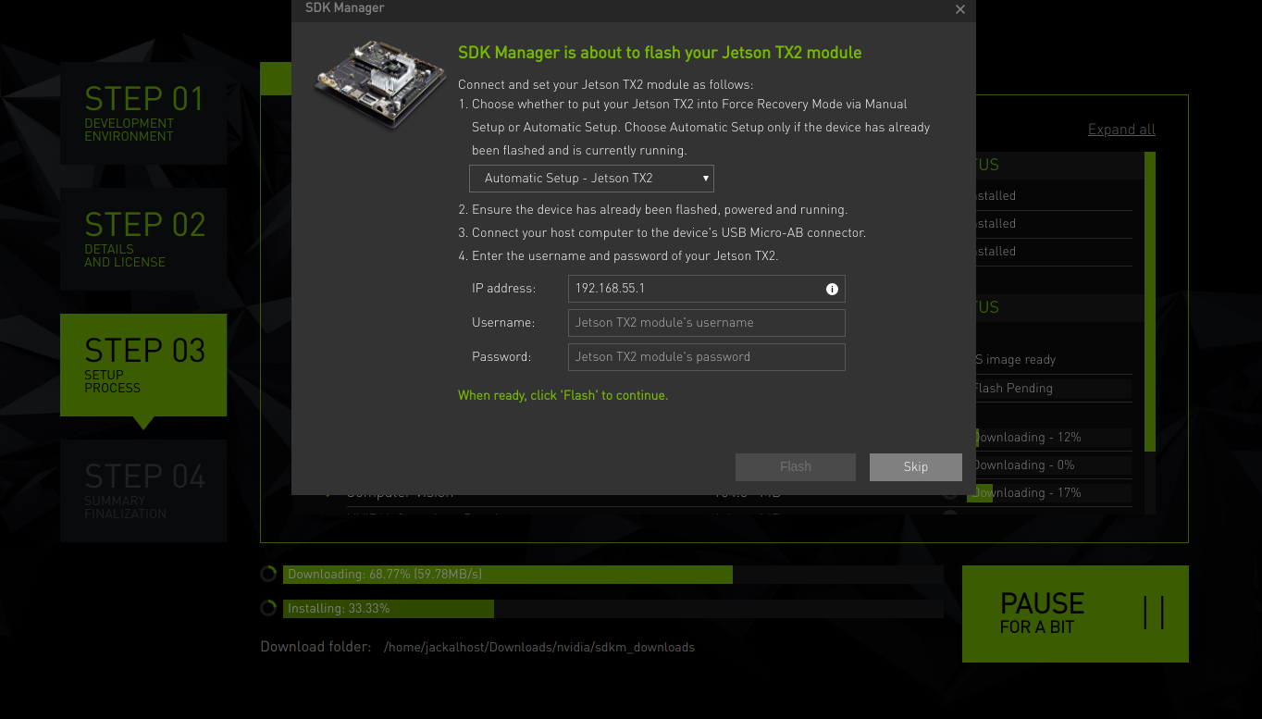
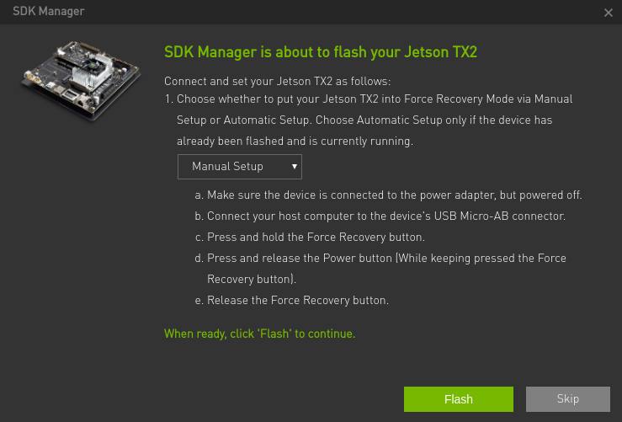
Step 7 - Start the Flash
If you did everything right so far, the download process will start.
At some point, you will encounter this window. Click on the drop-down menu and select “Manual Setup”.
Make sure you have backup all the data you need on the Jetson device.
Then click “Flash”.
SDK Manager will let you know if your Jetson device is properly connected or not. If not, just repeat step 4.

Slide 14
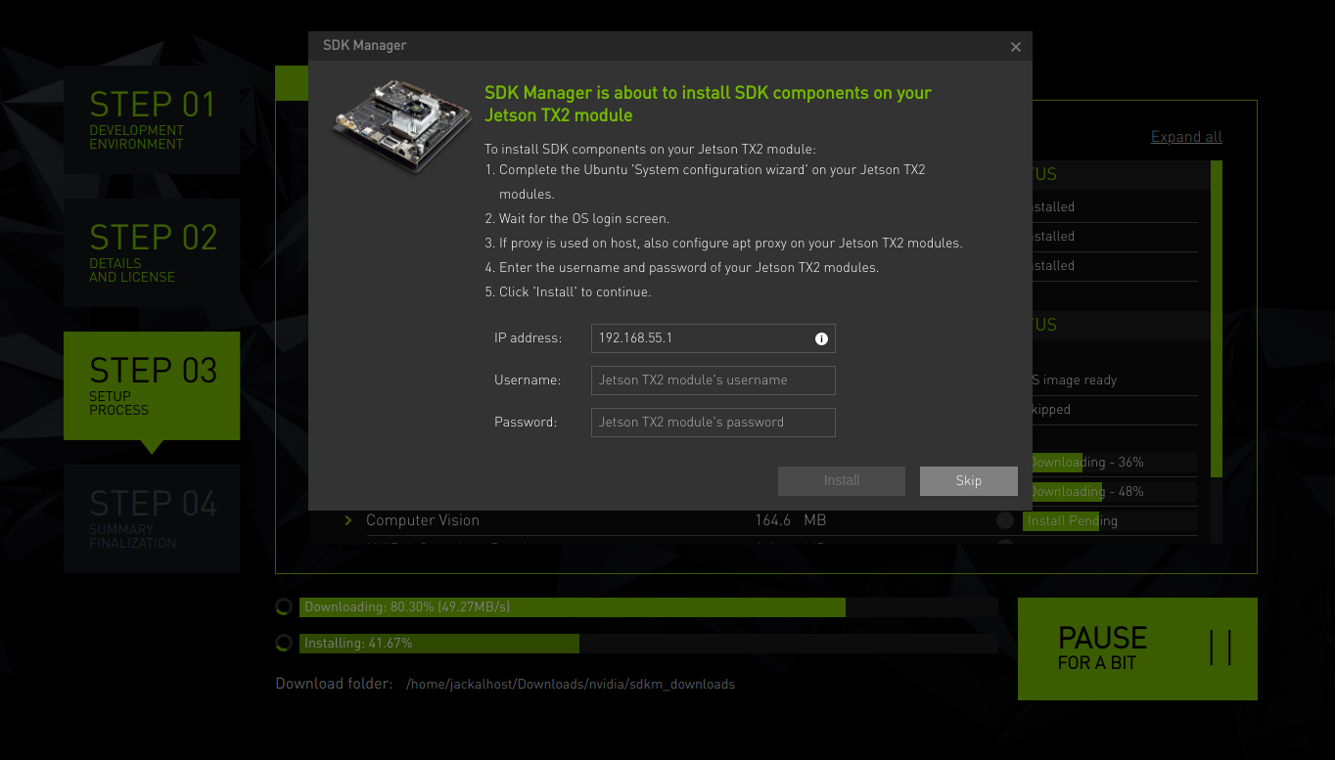
Step 8 - Ubuntu initial setup
Once the flashing is complete, you will see this screen.
Leave the Host Machine the way it is, connect a monitor, keyboard, and mouse to the Jetson device.
Go through the Ubuntu initial setup all the way until you see the Ubuntu desktop.
After you are done with the setup, go back to the Host Machine SDK Manager and fill in the Username and Password you used in the Ubuntu setup.
Then click “Install”.

Slide 15
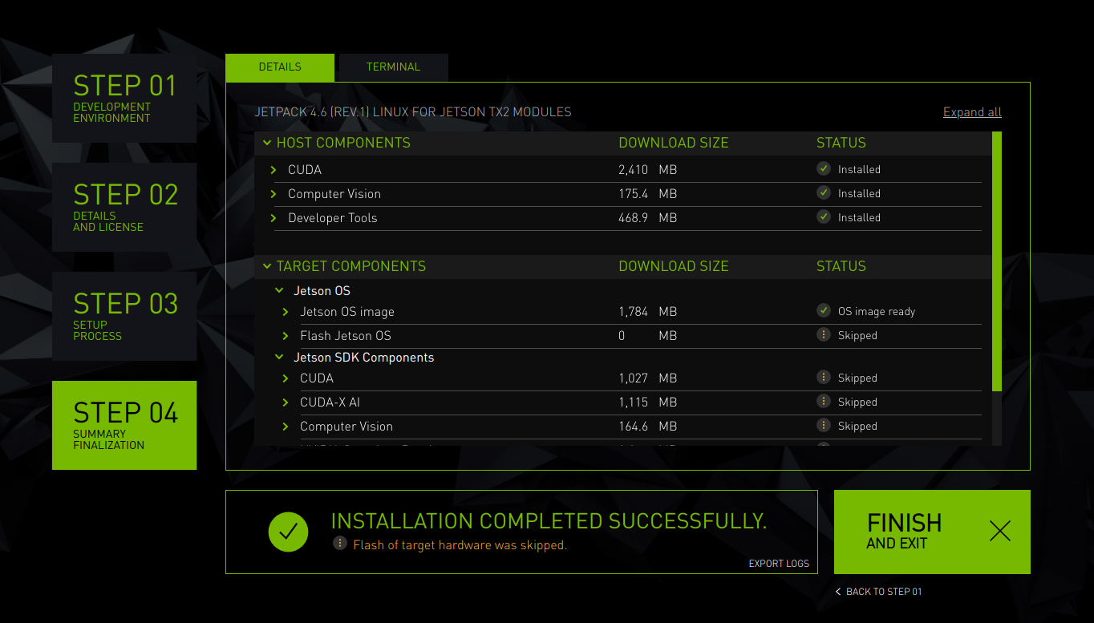
Step 10 - Done
If everything was done right, you will see this screen.
Now all the CUDA and computer vision libraries are installed and configured.
You are good to go! Just click “FINISH AND EXIT”.

Slide 16
JetPack Clone
https://elinux.org/Jetson/TX2_Cloning

Slide 17
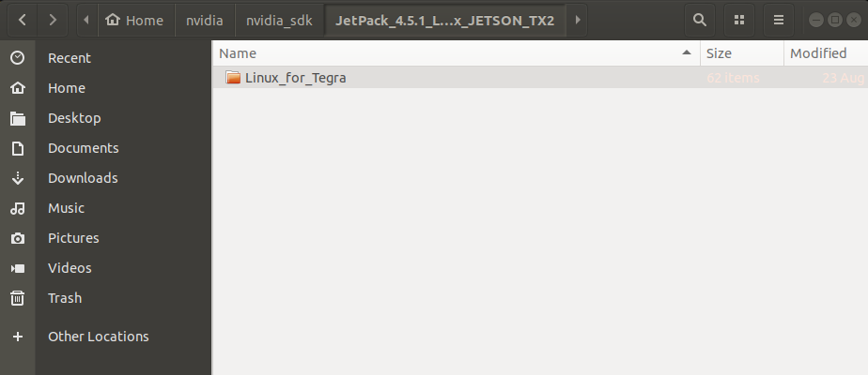
Step 1 - Find the Target HW image directory
Locate the “Target HW image folder” you selected in “JetPack Upgrade Step 3”.
If you haven’t done the JetPack Upgrade before on this Ubuntu machine. Go through the “JetPack Upgrade” guide without the Jetson device connected to the Ubuntu machine and click “Skip” in Step 7 and 8. After this, the SDK Manger will create the “Target HW image folder”. Be mindful, in Step 2, you should choose the JetPack version that matches the device you want to clone.
In the “Target HW image folder”, you will find the “JetPack_xx_JETSON_XX” folder. Inside it, you should find the “Linux_for_Tegra” folder.

Slide 18
Step 2 - Connect your Jetson device in recovery mode
Take the USB Micro-B to USB A cable (included in the developer kit) and connect your Jetson TX2 to the Ubuntu machine.
Connect the power cable of TX2. If you are using a battery, make sure it has enough battery to last ~ 2 hours of operation.
Put TX2 into Force Recovery Mode:
Starting with the device powered off (disconnect and connect power cable).
Press and hold down the Force Recovery button (holding).
Press and hold down the Power button (1 sec).
Press the Reset button once.
Hold the Force Recovery button for another 10 sec
then release.
Here is a video guide:
https://www.youtube.com/watch?v=HaDy9tryzWc
Note the footage is mirrored for some reasons.

Slide 19
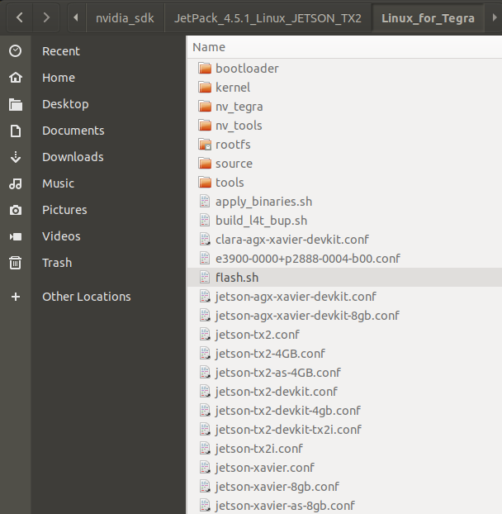
Step 3 - Start the clone using flash.sh
This guide assumes you are using a Jetson TX2 module, change the command line if you are using a different Jetson device.
Locate the “flash.sh” file.
Open a terminal in this directory.
Input the following command:
$ sudo ./flash.sh -r -k APP -G backup.img jetson-tx2 mmcblk0p1
The clone process should automatically start. Repeat Step 2 if the terminal tells you a connection failure occurs.
Once the clone finish, you will find a file named “backup.img” and a file named “backup.img.raw” in this directory. They are roughly 30 Gb each.
Then, type the following command in the terminal:
$ sudo cp backup.img.raw bootloader/system.img
This “system.img” file is what you should keep as the clone backup.
You can remove “backup.img” and “backup.img.raw” to save disk space. (optinal)

Slide 20
JetPack Restore
https://elinux.org/Jetson/TX2_Cloning

Slide 21
Step 1 - Find the Target HW image directory
Locate the “Target HW image folder” you selected in “JetPack Upgrade Step 3”.
If you haven’t done the JetPack Upgrade before on this Ubuntu machine. Go through the “JetPack Upgrade” guide without the Jetson device connected to the Ubuntu machine and click “Skip” in Step 7 and 8. After this, the SDK Manger will create the “Target HW image folder”. Be mindful, in Step 2, you should choose the JetPack version that matches the device you want to clone.
In the “Target HW image folder”, you will find the “JetPack_xx_JETSON_XX” folder. Inside it, you should find the “Linux_for_Tegra” folder.

Slide 22
Step 2 - Connect your Jetson device in recovery mode
Take the USB Micro-B to USB A cable (included in the developer kit) and connect your Jetson TX2 to the Ubuntu machine.
Connect the power cable of TX2. If you are using a battery, make sure it has enough battery to last ~ 2 hours of operation.
Put TX2 into Force Recovery Mode:
Starting with the device powered off (disconnect and connect power cable).
Press and hold down the Force Recovery button (holding).
Press and hold down the Power button (1 sec).
Press the Reset button once.
Hold the Force Recovery button for another 10 sec
then release.
Here is a video guide:
https://www.youtube.com/watch?v=HaDy9tryzWc
Note the footage is mirrored for some reasons.

Slide 23
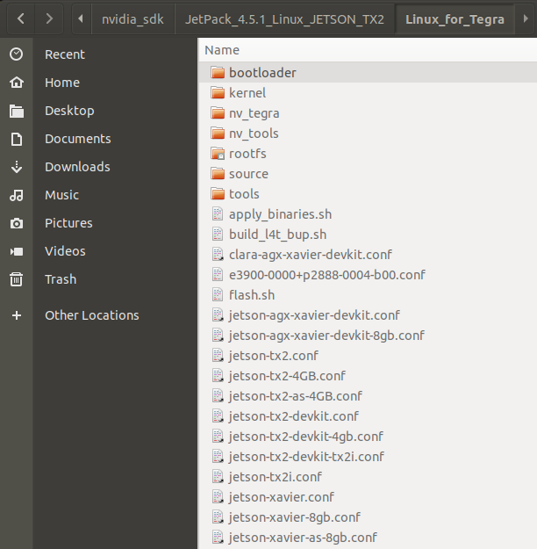
Step 3 - Find the bootloader folder
Locate the “bootloader” folder.
Copy your clone copy (should be named as “system.img”) into the bootloader folder:
bootloader/system.img

Slide 24
Step 4 - Start the restore using flash.sh
This guide assumes you are using a Jetson TX2 module, change the command line if you are using a different Jetson device.
Locate the “flash.sh” file.
Open a terminal in this directory.
Input the following command:
$ sudo ./flash.sh -r jetson-tx2 mmcblk0p1
The restore process should automatically start. Repeat Step 2 if the terminal tells you a connection failure occurs.
The entire process will take about 30 mins. Once done, you can use your Jetson device as usual.

